Slide 1
Network Design Proposal For Bank
Team Members:
Abdulhadi Al-Ahdal.
Ali Al-Madani.
Amar Al-Naqeeb.
Mohammed Al-Akwaa.
team members names and reg no

Slide 2
Abstract
In this project we design and implement Bank Network using Cisco Packet Tracer (CPT). Security breach in the sector of banks is one of the most important concerns that needs to be addressed as loss of information can lead to huge losses to the bank overall.
This project will help us curb such concerns by understanding the regulated flow of information/data. We will consider a national bank which has its head offices located in big cities like Sana'a. The other small branches will be present in cities like Al-Hudaydah, Ibb, Dhamar, Hadhramaut, and Aden. Employees use a special software to access user accounts. The level of access to advanced resources within the bank varies from employee to employee based upon several criteria which include the designation of the employee, criticality of the information etc. The typical servers, mail, web, files and directories will be made available to all the employees to understand the flow of work within the bank.

Slide 3
Introduction
An ideal Bank Networking system will be fully network base and easy with friendly user interface staff task management system where any banking system manage their networking system somehow Head office, Branch Office, and other office are maintain LAN, MAN, WAN, VLAN, VLSM,VPN and some branch are maintain by manageable switch. LAN is used by Local Area Networking systems for example one office and a building. And MAN are used by the Metropolitan area Network for Example small towns, and WAN are used by the WIDE AREA NETWORK. This networking system is used by all banking users to share their data very easily. So that every user can use Network Structure & Security of Banking System instantly this way anywhere.

Slide 4
Literature Survey
Review Paper | Network Topology | Security | Wired/Wireless Network | Cost Effective (CE)
1 | Star | No | Wired | No
2 | Hierarchical | Yes (TELNET) | Wired | No
3 | Hierarchical | Yes (TELNET) | Wired and Wireless | Less CE
4 | Star | No | Wired | No
5 | Star | Yes (TELNET) | Wired and Wireless | Less CE
6 | Star | Yes(Switchport security and ACL) | Wired | No
7 | Hierarchical | WEP/WPAPSW WPAL | Wired and Wireless | Less CE
8 | Star | No | Wired | No

Slide 5
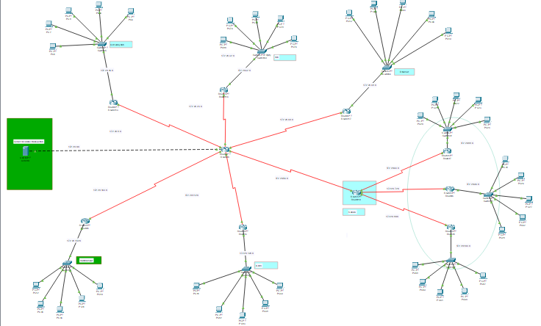
Architecture diagram and implementation
Implementation – Cisco Packet Tracer:
For implementing this bank prototype, we have used Router-PT which have serial ports, So that it will be easy for us to connect to 6 branches and we have also used 2960-24TT switches all over the network to connect to various campuses among the cities which are then interconnected to the servers and users. All the serial ports are assigned with IP addresses so they can be recognized between the cities without confusion.

Slide 6
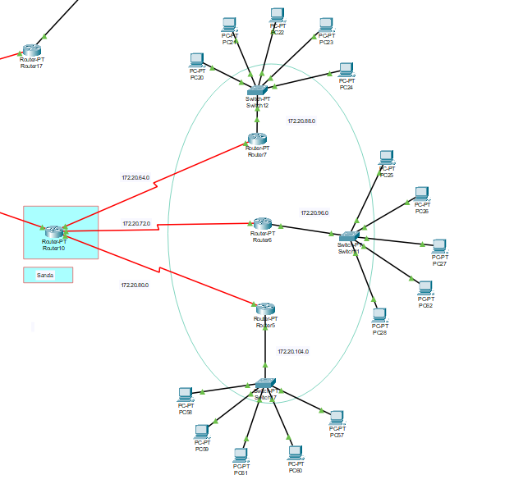
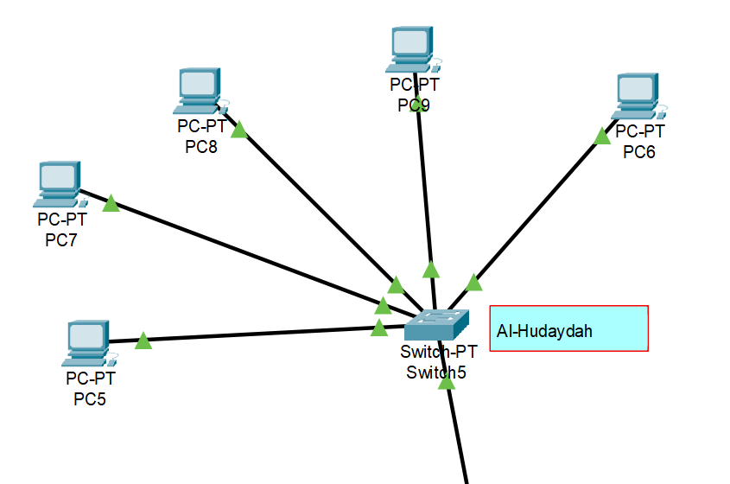
Sana'a – Network Topology
Al-Hudaydah – Network Topology:

Slide 7
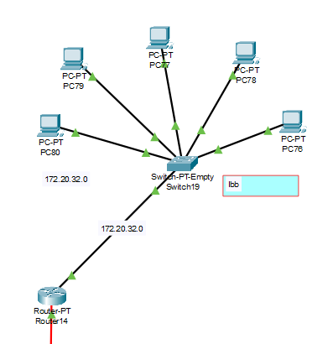
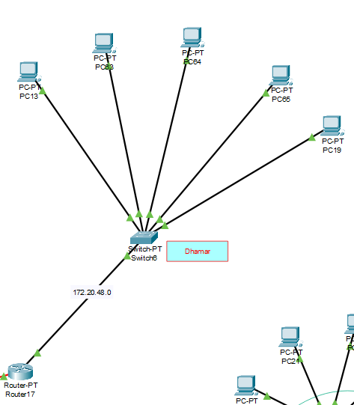
Ibb – Network Topology
Dhamar – Network Topology

Slide 8
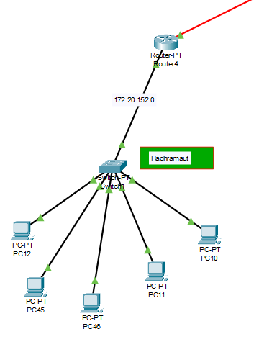
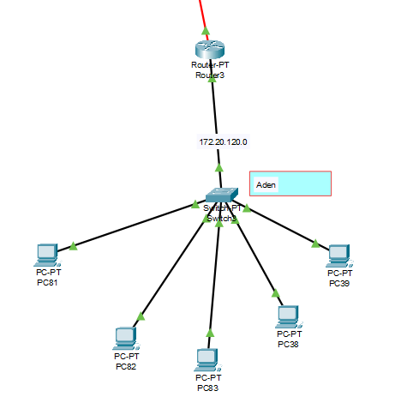
Hadhramaut – Network Topology
Aden – Network Topology

Slide 9
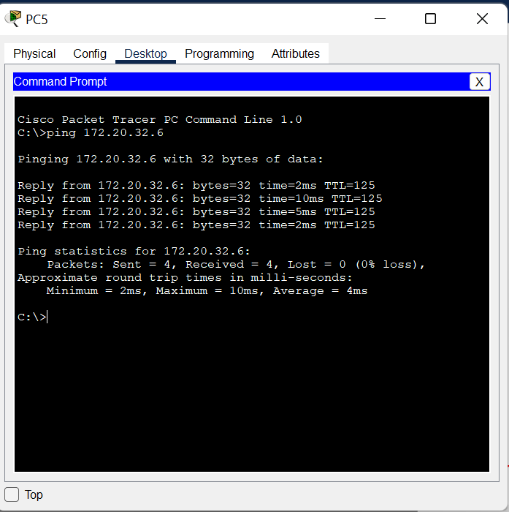
Output Screenshot

Slide 10
Conclusion
Had a deep understanding of how switches, routers and PCs are interconnected to form an in-house network.
And also learned how the data is transmitted among different networks using the IP address.

Slide 11
Thank You

